Slide 1

EUROfusion C&S development for IVCs: from ITER to DEMO
G. Aiello, G. Pintsuk, D. Terentyev, M. Rieth, P. Lamagnère, S. Madabusi, R. Roshan and the DDC-IC development team
EUROfusion
With contributions from WPMAT and F4E TBM project teams.

Slide 2
Issues in selecting C&S for Fusion SSCs
C&S are developed to comply with regulations, but there is no harmonized regulatory framework for fusion installations.
Existing C&S address SIC components in fission plants but fusion plants have different safety challenges compared to fission.
“Mission critical” components (magnets, IVCs) may not be SIC and exempted from regulation but must still be designed, manufactured and operated to the highest quality standards (investment protection).
The wide range of operating conditions of fusion SSCs (operating temperatures from 4 K to 2000 K, EM loads linked to electrical functionality, strong cyclic operation, effects of 14 MeV neutron irradiation, plasma-wall interactions leading to materials degradation, etc.) are not covered by any single existing industrial code.
A multi-code approach was selected from the beginning for ITER SSCs,
complemented by specific design rules and Technical Specifications

Slide 3
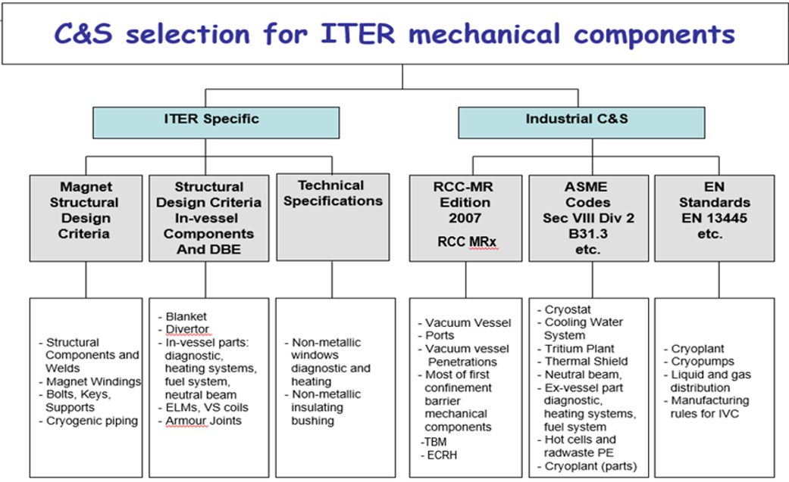
C&S for mechanical components used in the ITER Project
Industrial codes:
RCC-MR(x): for primary confinement barrier (VV) and SIC/nuclear components under ESPN regulation (TBM).
ASME (non-nuclear): for piping, valves, pumps, vessels and SIC classified under the EU PED/ESP regulation (CWS).
EN standards: for selected components, complementary to ASME for specific EU regulation requirements.
ITER Specific:
SDC-IC: for IVCs, to take into account neutron irradiation effects and fusion specific material properties. Includes Design By Experiment for DIV.
Magnet-SDC: for cryogenic temperatures, where loss of FT and defects acceptability are the main concern.
Technical Specifications: for non-standard components and ITER (fusion) specific requirements (Tritium, Vacuum…).
ITER had to produce additional documentation to justify the coherency and consistency of the different codes

Slide 4
The EUROfusion and F4E strategy: following the ITER approach for IVCs
EUROfusion, in collaboration with F4E, is following a similar approach for IVCs:
We are supporting F4E in the development of RCC-MRx:
    RCC-MRx is the code selected for the EU TBMs (ESPN N2 components).
    We are focusing on the codification of EUROFER97 material properties, both for base metal and joints in irradiated and non-irradiated conditions and the validation of (elastic) design-by-analysis rules.
    These developments, and the corresponding lessons learned will be essential for the development of C&S for DEMO IVC (in particular the BB) .
  We are developing the DEMO Design Criteria for In-vessel Components (DDC-IC), with multiple aims:
      Complement and extend design rules in existing C&S to cover the operational domain of DEMO IVCs.
      Act as a guideline for designers, providing references on how to use existing C&S and integrate DDC-IC rules in the design assessment.
      Provide alternative damage classification schemes able to capture the specific failure modes of fusion IVCs and their consequences in terms of functionality.

Slide 5
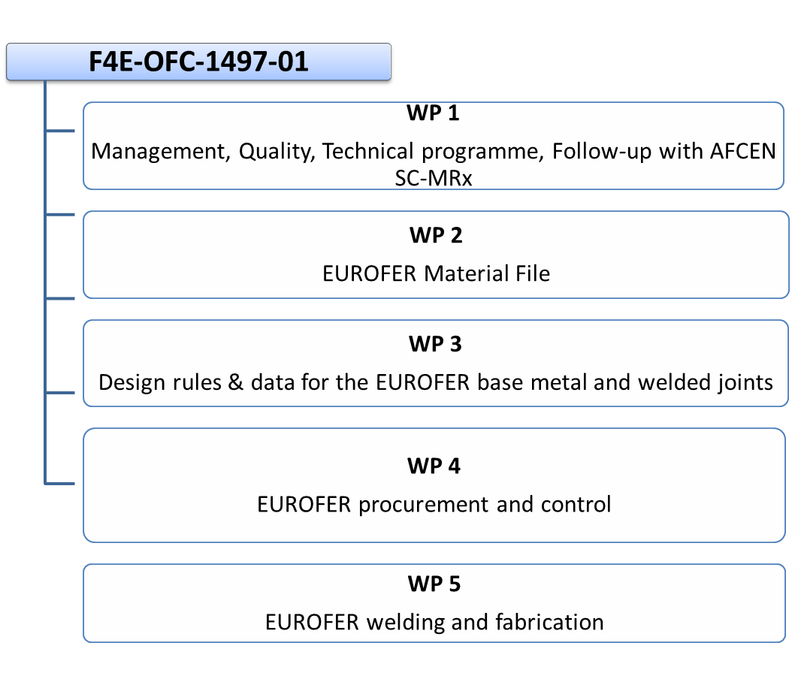
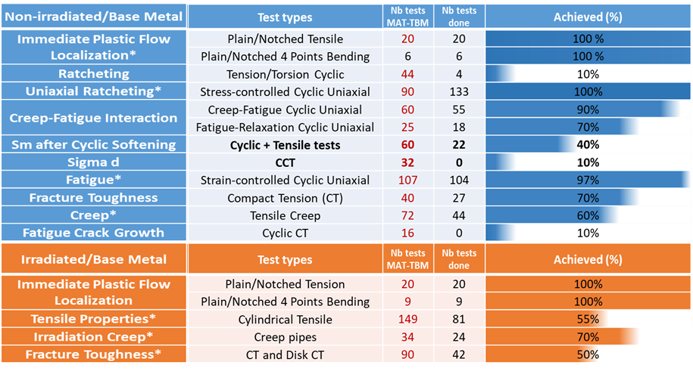
Collaboration with F4E: introduction of EUROFER in RCC-MRx
EUROfusion WPMAT/MAT-TBM:
characterization of EUROFER batch 3 and 4 according to AFCEN “Guide for introducing a new material in RCC-MRx”.
F4E- OFC-1497-01:
supply of services for the technical management, codification and justification of the integration of EUROFER steel in the RCC-MRx code for ITER TBMs application.
EUROfusion is in charge of providing basic material properties and performing dedicated experiments for validation of design rules
F4E (with partners CEA and FRAMATOME) is in charge of post-processing the data to derive design allowables and submit corresponding DRMx to AFCEN
→ 01PL2, D. Terentyev
Courtesy of Y. Poitevin (F4E)

Slide 6
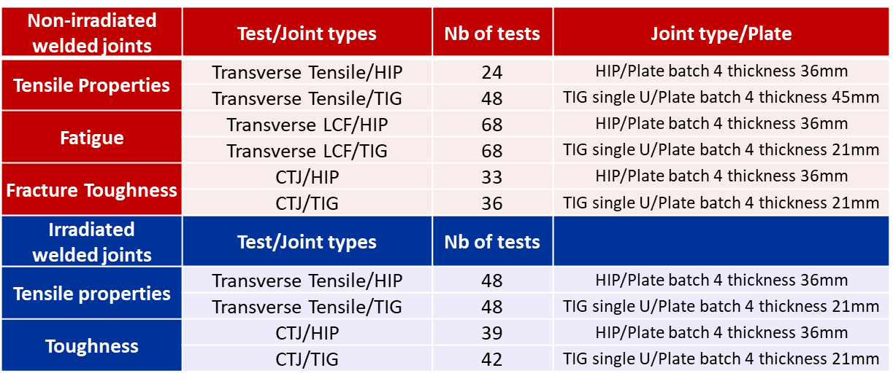
Collaboration with F4E: manufacturing techniques for the EU-TBMs
F4E- OMF-1070:
Weldability study and preliminary Welding Procedure Specifications (pWPS) for TBM and sub-components
YAG laser welding + Hot Isostatic Pressure (HIP) Diffusion Welding (DW)
Cooling Plate-reference process (thickness 6.5 mm)
Stiffening Plates(thickness 11 mm)
Side Caps / First wall (thickness 30 mm)
Tungsten Inert Gas (TIG) welding with and without filler material
TBM box assembly (30 mm)
2-step HIP process – low pressure & high pressure HIP
Cooling Plate – alternative process
TBM box First Wall – alternative process
Drilling + Spark erosion + Bending
→ 01PL2, D. Terentyev
TIG welding robot
EUROfusion WPMAT/MAT-TBM:
characterization of Welding Joint properties
→ 02F1I, M. Zmitko

Slide 7
The DEMO Design Criteria for In-Vessel components in EUROfusion
The DDC-IC will be a fully integrated guideline adopting inelastic design procedure supported by advanced FE based assessment approaches to avoid relying on (over)conservative margins associated with elastic design methods.
Is not meant to be a stand-alone code but to provide links and guidelines to apply existing C&S (ASME, SDC-IC, RCC-MRx).
Provide complementary or alternative design rules to cover gaps in existing C&S.
Provide design allowables and material properties for fusion-relevant materials and DEMO loading conditions (in particular neutron irradiation) in parallel with the development of specific Material Properties Handbook.
Introduce an alternative damage classification methodology tailoring the damage limits for each specific failure mode to the required functionality of the component in the different plant states.
Provide specific sections for selected components to instruct designers on the methodology to follow, i.e. tailored components’ Design Specifications

Slide 8
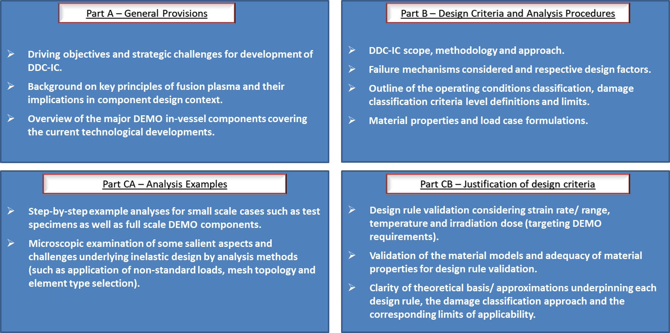
The DDC-IC structure

Slide 9
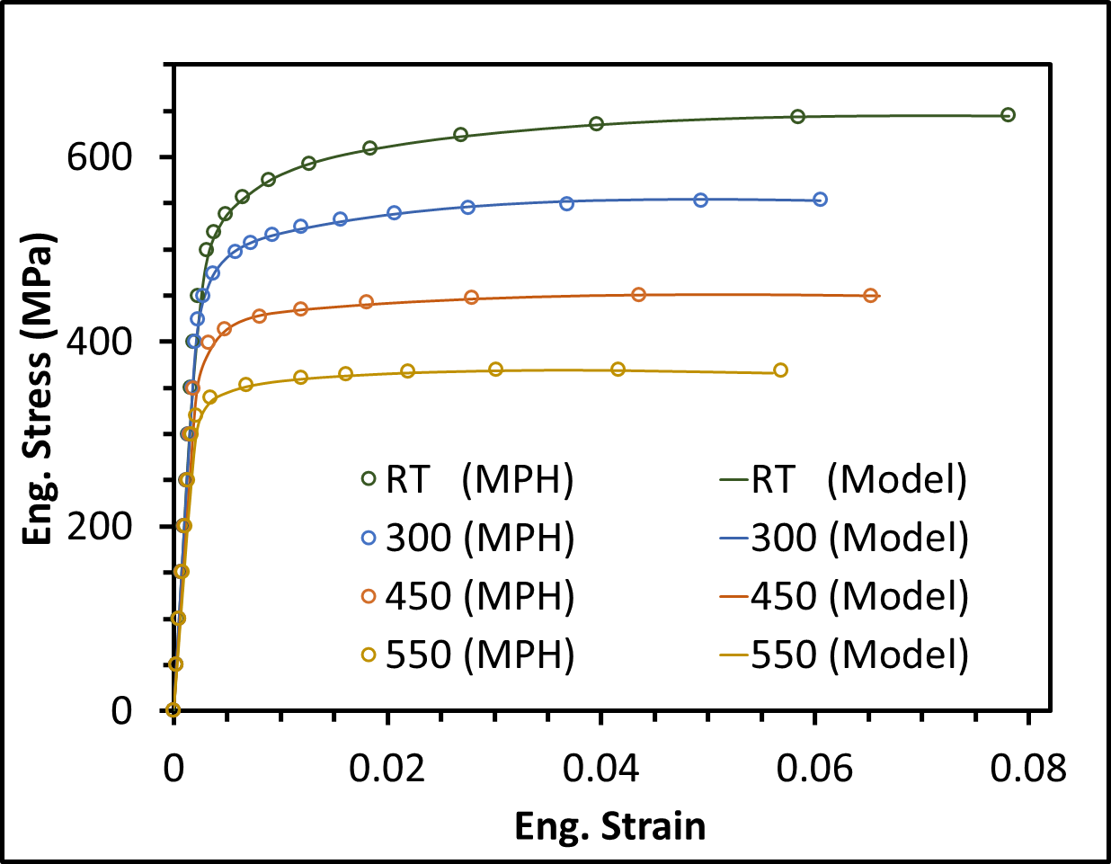
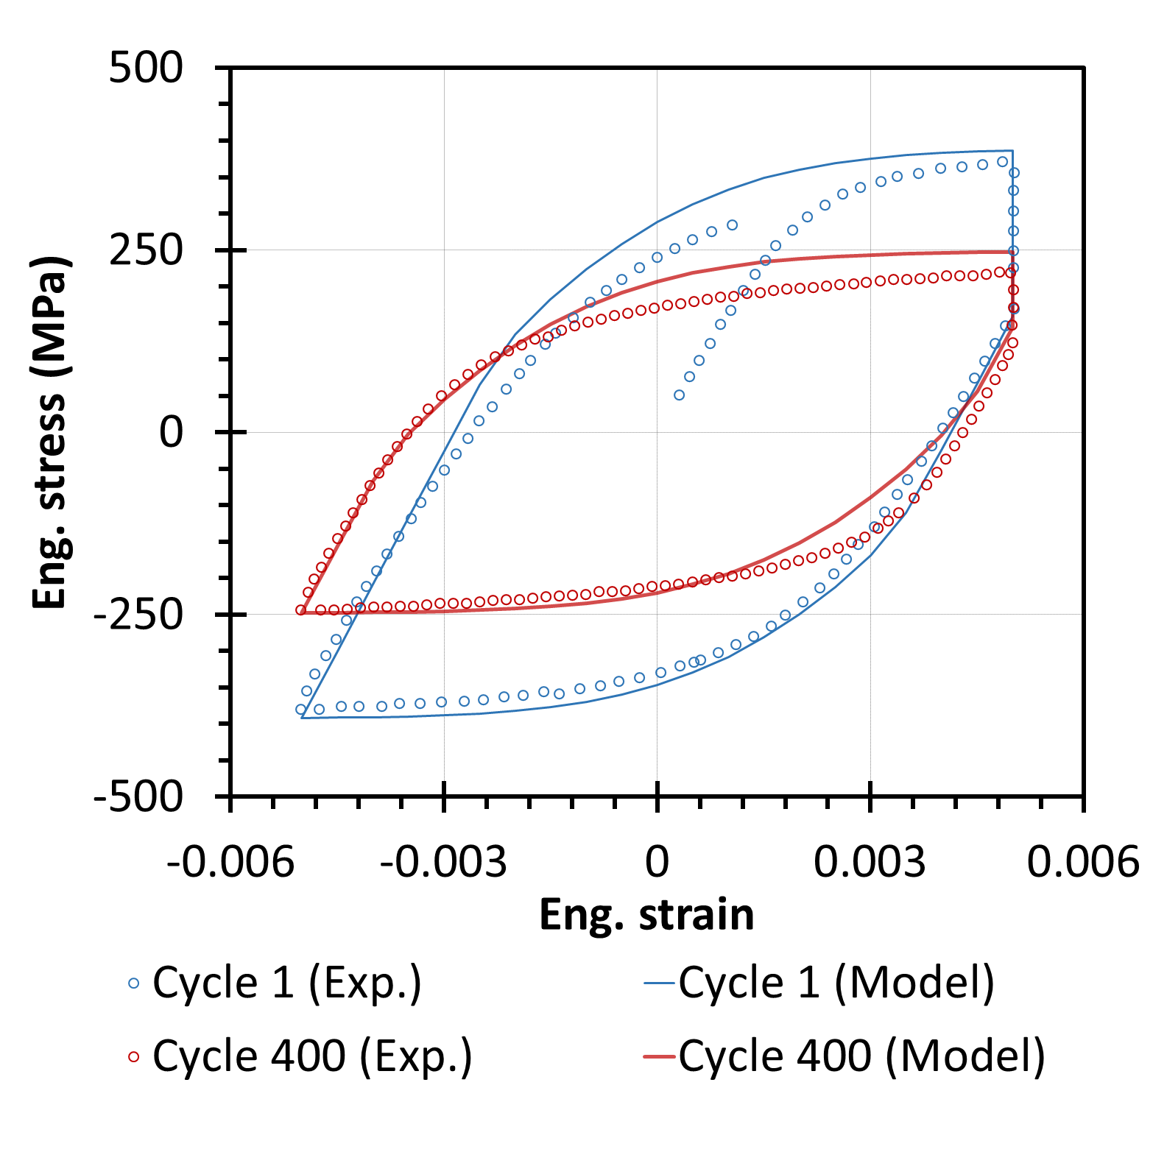

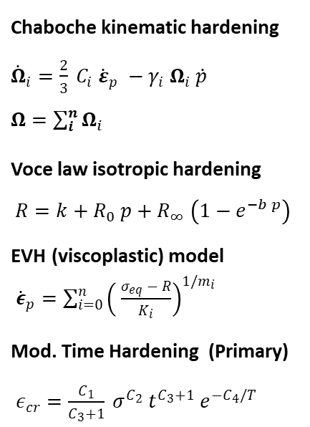

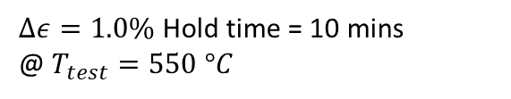
Development and validation of constitutive material models
Monotonic load
Cyclic load with hold time
Material : EUROFER97
Hardening laws are combined to build material models
Chaboche kinematic hardening ${\dot{Ω}}_{i}=\frac{2}{3} C_{i} {\dot{ε}}_{p} −γ_{i} Ω_{i} \dot{p}$ $Ω=\sum_{i}^{n}{Ω_{i}}$
Voce law isotropic hardening $R=k+R_{0} p+R_{∞} \left(1−e^{−b p}\right)$
EVH (viscoplastic) model ${\dot{ε}}_{p}=\sum_{i=0}^{n}{{\left( \frac{σ_{eq} − R}{K_{i}}\right)}^{1/m_{i}}}$
Mod. Time Hardening (Primary) $ε_{cr}=\frac{C_{1}}{C_{3}+1} σ^{C_{2}} t^{C_{3}+1} e^{−C_{4}/T}$
Monotonic
Cyclic, creep and hold time
Cyclic
Loaded till UTS
@$T_{test}=RT−550 °C$
$Δε=1.0\%$ Hold time = 10 mins
@ $T_{test}=550 °C$
Material Property Handbook – Eurofer97 (2023)
J. Aktaa and R. Schmitt, FED (2006)
Next steps:
Experimental tests for validation on CuCrZr
Extension to irradiated conditions
→ A. Zinovev, 03A1I
→ R. Rajakrishan, P3-124

Slide 10
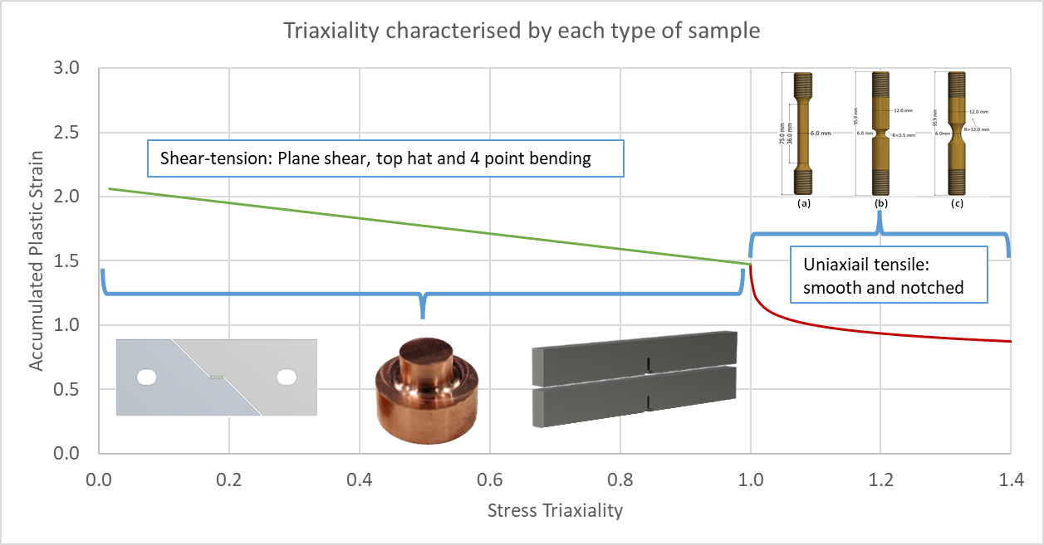
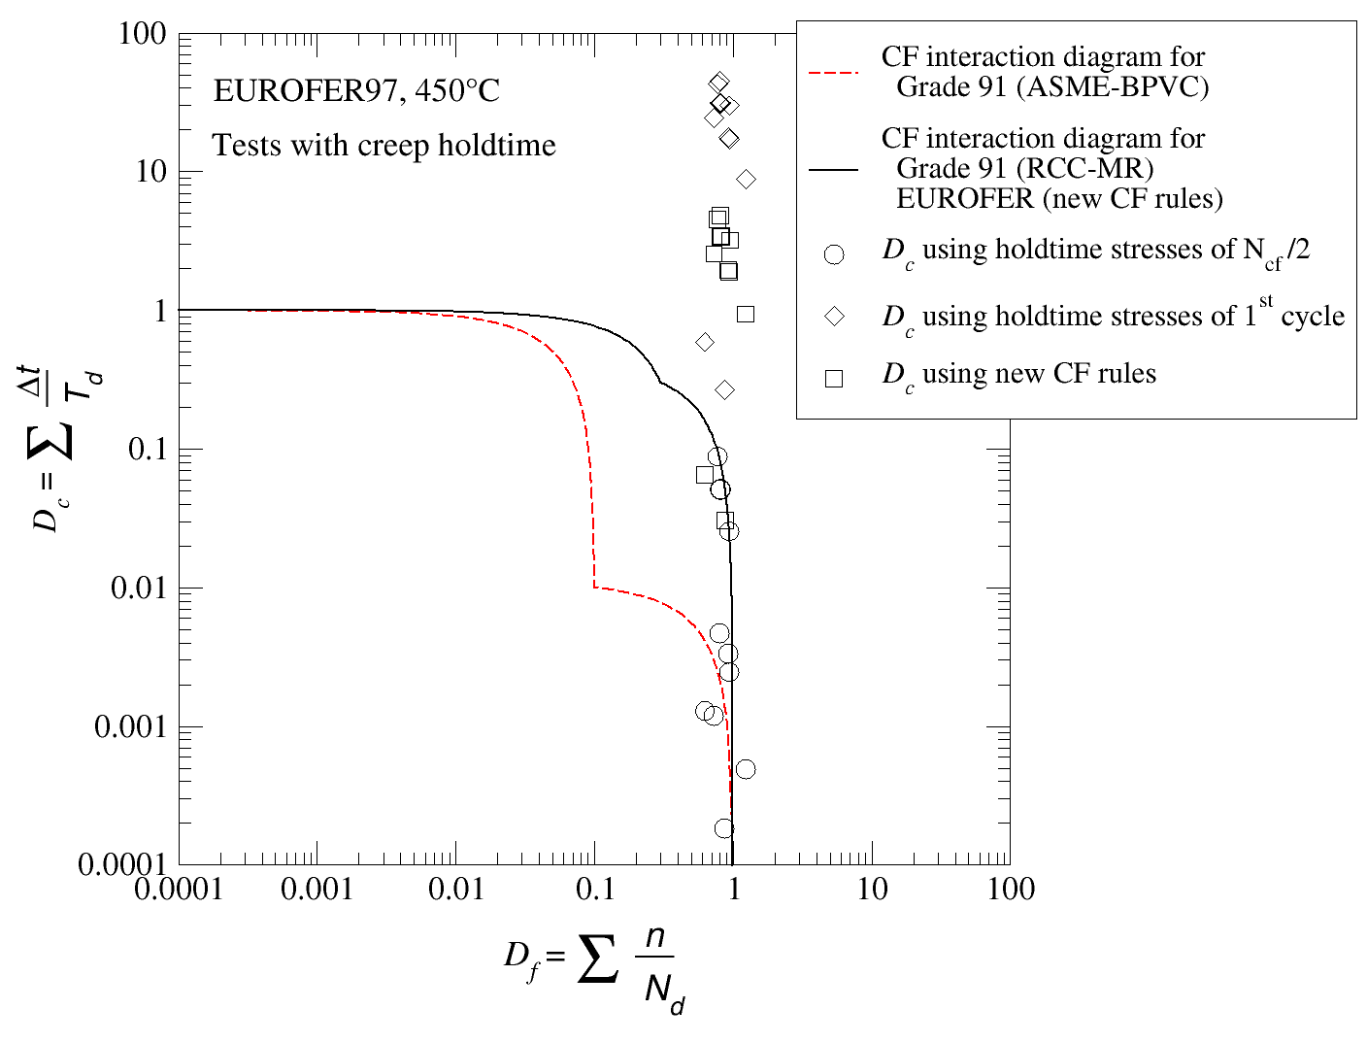
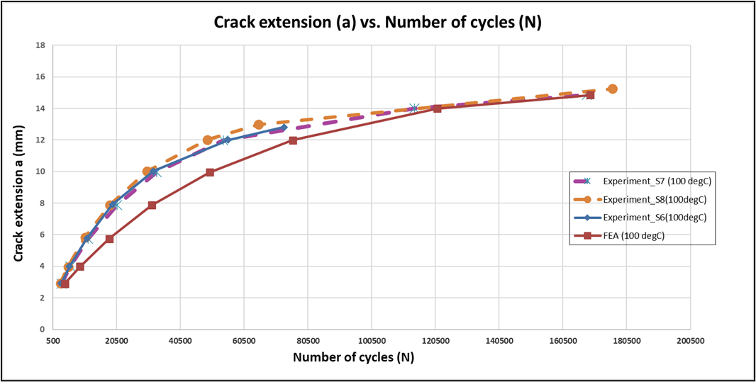

Development and validation of design rules for inelastic analysis
Different specimens for different triaxialities
Failure envelope CuCrZr@RT
Exhaustion of ductility
  Determination of the actual failure envelope
  by non-standard test at different triaxialities
  Validated on CuCrZr and EUROFER97 at different
Multiaxial fatigue
  To reduce conservatism on the fatigue
  design curve (N/20 or ε/2)
  Validation for EUROFER97 on going
Creep-fatigue interaction
  To account for cyclic softening, between
  ASME (overconservative) and RCC-MRx (not conservative)
  Validated on EUROFER97, CuCrZr on-going
Fast fracture
  To define a master curve for W based on Weibull
  model and the Cohesive Zone Elements method
  Validated in un-irradiated conditions, on-going for
  irradiated conditions
Fatigue crack growth
  Alternative method to calculate the J-integral in elasto-plastic materials
  Validated on CuCrZr, validation for EUROFER97 on-going
NEXT STEP: validation on irradiated specimens
Creep-fatigue and fatigue-relaxation tests.
RCC-MRx
DDC-IC
Creep-fatigue interaction diagram (0.3,0.3)
different conservatism using different rules.
ASME
→ M. Jetter, P2036
$$J=\frac{1}{B}\frac{dUe}{da}$$
Validation on CuCrZr CT specimens (100°C)

Slide 11
Alternative damage classification scheme (limit state/inelastic analysis)
Criteria Level | Failure modes | Damage limit | Meaning
Level A/B | Failure mode 1 | No damage | Component can be operated indefinetly
 | Failure mode 2
 | Failure mode 3
Level C | Failure mode 1 | Limited Damage | Component can be repaired or changed, operation can be continued
 | Failure mode 2
 | Failure mode 3
Level D | Failure mode 1 | Ultimate damage | Component must be changed, or continuation of operation may not be possible
 | Failure mode 2
 | Failure mode 3
Present approach used in nuclear C&S
Criteria Level | Failure modes | Damage limit | Meaning
Level A/B | Failure mode 1 | No damage | Design is expected to resist the onset of this failure mode with a wide margin (over the design life).
 | Failure mode 2 | Limited damage | Design is expected to resist the onset of this failure mode with a reduced margin (over the design life).
 | Failure mode 3 | Ultimate damage | The design is expected to meet (or exceed) the conditions for onset of this failure mode (over the design life)
Alternative approach proposed for DDC-IC
The DDC-IC approach is specific to each component

Slide 12
Use of R6 failure assessment curve for setting damage limits
Basic rationale
The R6 failure assessment procedure indicates that the plastic damage accumulation has an influence on the margin against fast fracture.
This can be used for design assessment considering crack growth and plastic strain accumulation (in the remaining ligament).
Proposed approach
Predetermining “design limits” against brittle fracture and plastic damage by considering the R6 failure assessment curve boundary.
These limits may be suitably modified further considering component quality class/ limit state requirements.
Envisioned advantages
Provides a theoretical basis to justify the adopted margins against brittle and ductile failure considering the synergistic effects.
Preferable to assessment against each failure mode in isolation (which may be non-conservative).
The overall aim of this approach is to provide a higher level of granularity in the structural integrity assessment of DEMO in-vessel components with clear justification for design limits against different failure modes.

Slide 13
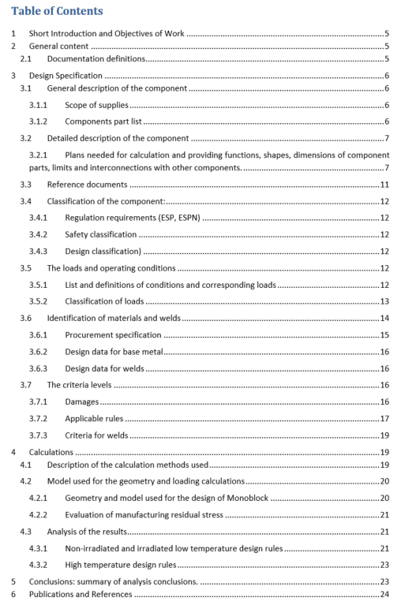
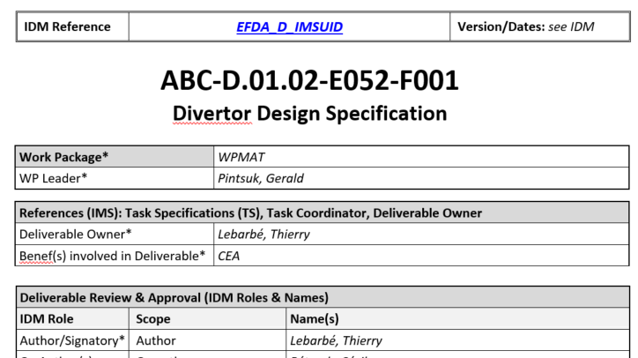
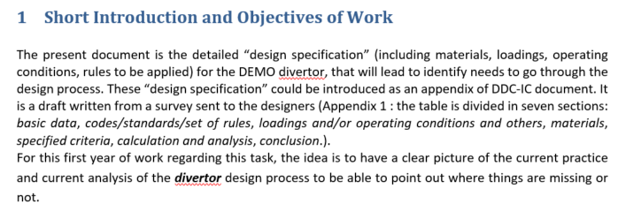
Introduction of component-level “Design Specification”
  Objective:
  To have a clear picture of the current practice of structural analysis of each component’s design process to be able to draft a “design specification” (“state of the art”)
  To ensure coherency (“harmonization”) of design rules used for analyses
  Not limited to design analyses: component classification, operating conditions, loads, materials and manufacturing shall at term be included

Slide 14
Extending the domain of applicability to DEMO operating conditions
There is a lack of data on the effects of neutron irradiation at high dpa levels (20-50 dpa for EU-DEMO) and high neutron energy (14 MeV): change in physical properties (thermal conductivity, electrical resistivity), hardening, shift of DBTT, irradiation induced creep and swelling.
Applicability of design rules for neutron irradiated materials must be proven.
Irradiation campaigns to fill these gaps are part of the EUROfusion program:
→ 29PL1, M. Rieth
Irradiation creep, T_{irr}=325°C (BOR-60)
Courtesy of D. Terentyev, SCK-CEN.
Swelling, T_{irr}=325°C (BOR-60)
A 14 MeV irradiation facility (DONES) is required to complete the database

Slide 15
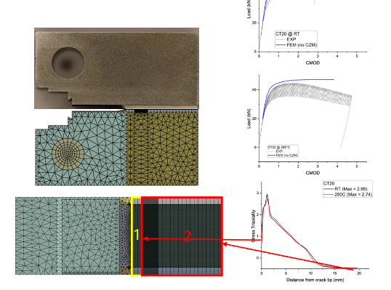
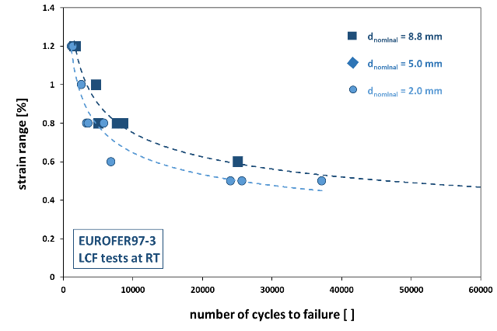
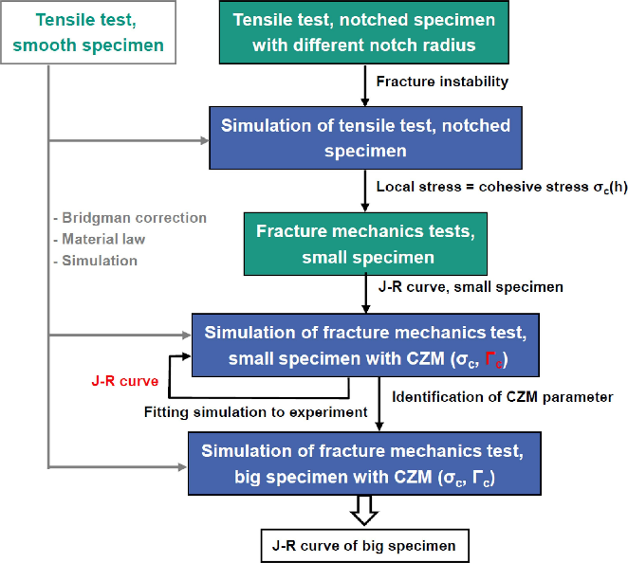
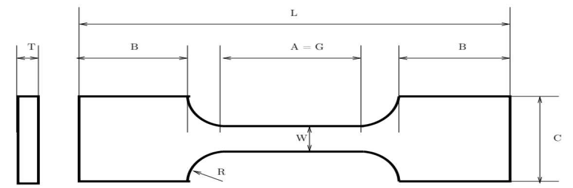
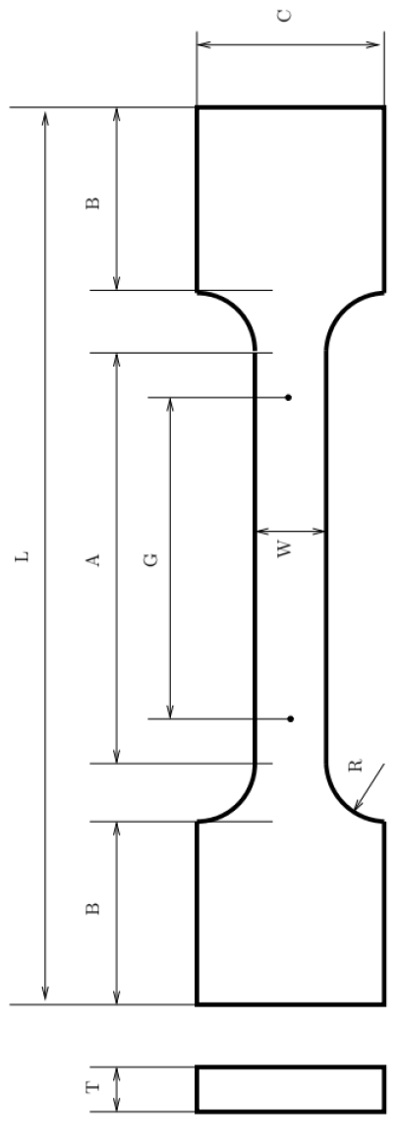
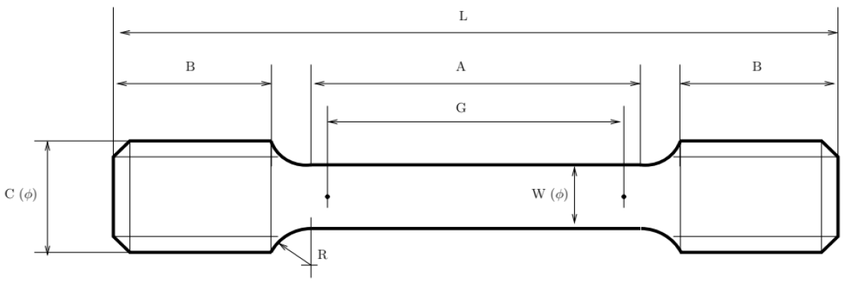
Standardization Small Specimen Test Techniques (SSTT)
Need to ensure “Code-qualified” data for irradiated material properties
OBJECTIVES: propose SSTT for tensile, fatigue, FT and FCG testing, and respective sample geometries → Prepare the guidelines (for ISO/ASTM review/approval)
→ 01A3, E. Gaganidze
Tensile properties
LCF
Fracture toughness
Pilot Run (PL), according to ASTM guidelines completed by EU labs at RT, 300°C and 550¨C
Next step: Interlaboratory Study (ILS), open to international partners (JA, CN).
Contribution to ASTM E8/E8M by end of 2025.
Tests on:
  lab-specific sub-sized specimens (D = 2 mm & 5 mm)
  standard sized specimens (D = 8.8 mm)
Strain controlled LCF tests in air at RT & 550°C
Underestimation of fatigue life w.r.t standard specimens → correction factor needed.
Combined procedure of experimental tests on small size specimens and FEM simulation to reconstruct the J-R curve of “standard-size” specimens.

Slide 16
Conclusions: extending existing C&S to DEMO IVCs
ITER has already provided a significant contribution to the development of C&S for IVCs:
  By implementing specific evolutions in industrial C&S (RCC-MRx).
  By developing a set of criteria and related material properties for the specific damage modes of ITER IVCs (SDC-IC).
EUROfusion, in collaboration with F4E, is following a similar approach:
  We are supporting F4E in the development of RCC-MRx for the Test Blanket Modules.
  We are developing DDC-IC to extend the domain of applicability of existing C&S to DEMO relevant materials and operating conditions.
In parallel, we are also investigating innovative approaches:
  Proposing an alternative damage classification scheme, based on inelastic assessment route and limit state notion for component’s functionality.
  Developing dedicated “Design Specifications”, for selected, critical IVCs collecting the lessons learned in design, building and operating similar components in existing Tokamaks.

Slide 17
Conclusions: towards a collaboration with ITER
Identification of SIC and essential safety functions in the different plant states.
Correspondence between ESR and selected C&S (under agreement with safety authorities).
Identification of “mission critical” components and functionalities.
Ensure consistency in design when different C&S are used for interfacing components.
Feedback from manufacturing and qualification of components (and later from operation).

